Slide 1
Agenda for GEOG260/360 GIS & Land Change Models
October 23
Grades for Assignment 6
Discuss Assignment 7
October 25
Tanner office hours are moved to 10-noon in the Academic Commons
Sushil will be on zoom 1-3pm
Submit Assignment 7 by 4pm on Canvas
Get instructions for Assignment 8
October 30
Discuss Assignment 8
November 1
Submit Assignment 8 by 4pm on Canvas
Get instructions for Project Proposal

Slide 3
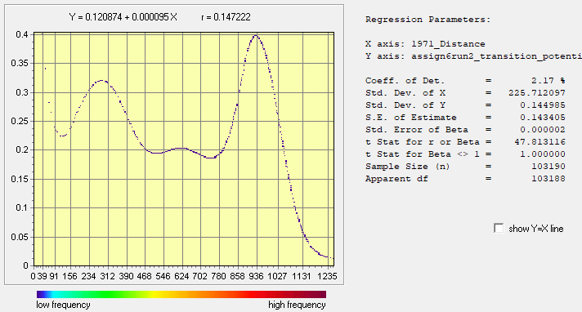
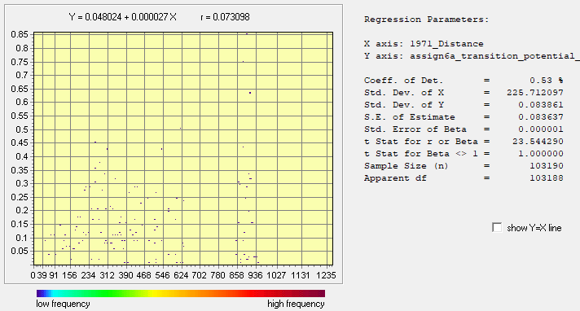
SVM & Decision Forest Transition Potentials & Regress modules( Forest to Other)
Run A
Run B
Relationship between Distance and Transition Potential from 1 to 2 (SVM)
Relationship between Distance and Transition Potential from 1 to 2 (DF)
x = 1971- Distance to Built
y = Transition potential from Forest to Other
x = 1971- Distance to Built
y = Transition potential from Forest to Other

Slide 4
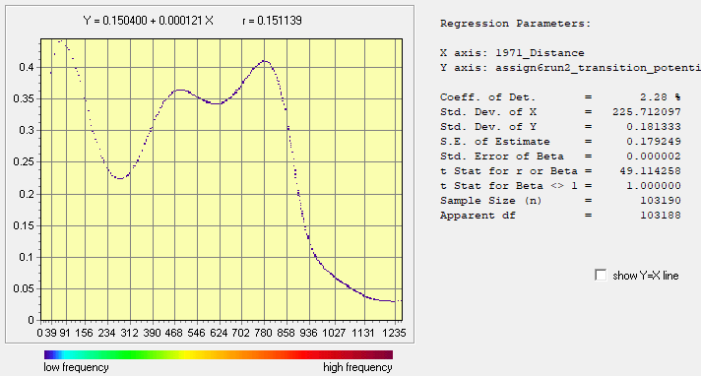

SVM & Decision Forest Transition Potentials & Regress modules( Forest to Built)
Run A
Run B
Relationship between Distance and Transition Potential for 1 to 3(SVM)
Relationship between Distance and Transition Potential for 1 to 3(DF)
x = 1971- Distance to Built
y = Transition potential from Forest to Built
x = 1971- Distance to Built
y = Transition potential from Forest to Built

Slide 5

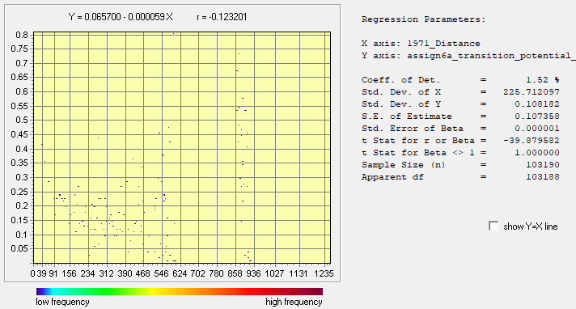
SVM & Decision Forest Transition Potentials & Regress modules(Other to Built)
Run A
Run B
Relationship between Distance and Transition Potential for 2 to 3(SVM)
Relationship between Distance and Transition Potential for 2 to 3(SVM)
x = 1971- Distance to Built
y = Transition potential from Other to Built
x = 1971- Distance to Built
y = Transition potential from Other to Built

Slide 6
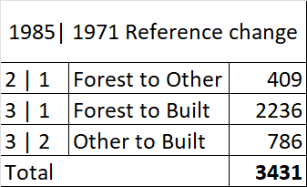
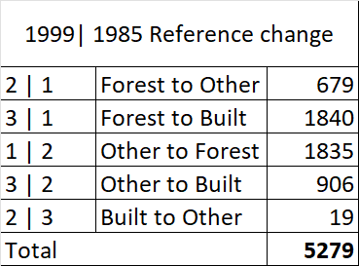
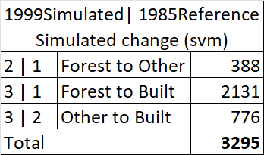
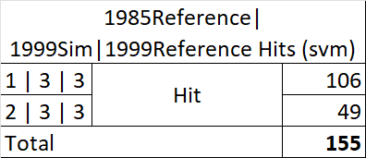
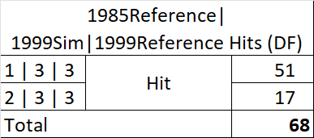
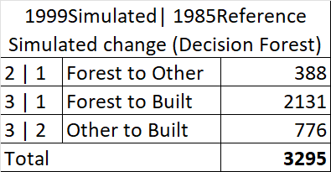
Simulated Change from 1985 – 1999 validation using CrossTab
A
B
C
D
The total number of Hits using SVM is 155 as shown in Table D, of which 106 were simulated as the change from Forest to Built and 49 changed from Other to Built, and were actually Built in the 1999 reference.
During the 1985-1999 time interval, the simulated change is 3295 pixels ( Table C) and the reference change is 5279 pixels as indicated in Table B.
Also applying the crosstab of 1971 and 1985, the total reference change between calibration time is 3431 pixels (Table A). These changes are Forest to Other (409), Forest to Built (2236), and Other to Built (786).
The difference between the change during the calibration and validation time intervals shows that the pattern of change has accelerated. Also, the simulated change is lesser because the inputs that the Land Change Modeler (LCM) uses in the extrapolation is the change from the calibration period and Markov’s matrix and thus does not have any information about the quantity of change in 1999. Also the the simulation based on linear change which in actuality isn’t. Hence the difference in the quantity of change.
Decision Forest on the other hand produced total Hits of 68 as shown in Table E, of which 51 were simulated change from Forest to Built and 17 Other to Built, and were actually Built in the 1999 reference map.
During the 1985-1999 time interval, the simulated change is 3295 pixels ( Table F).
E
F

Slide 7
Factors to consider in choosing an algorithm
Most of the algorithms used in land change modelers to simulate the quantity of change, however, these models for example the Land Change Modeler use inputs that do not include any details or information about the quantity of change during the validation period. This would result in any algorithm used to either overpredict or underpredict the change. Therefore, I would suggest that the researcher chooses an algorithm that the researcher can understand and control, the researcher’s audience can understand, and an algorithm that is relevant to the research question.
Additionally, in choosing an algorithm, there should be adequate documentation about how it operates. The documentation must include information about how the model overfits or underfits relationships to patterns and whether the behavior matches what the documentation states. Thus, if scientists determine that the model behaves as the documentation advertises, then they can conclude that it is verifiable. If the model and algorithm generate a relationship that is specific to the pattern of the calibration data then it is overfitting. Finally, since these models and algorithms are used to simulate the patterns in the data and then to extrapolate into the future, it is important to compare these simulations to real-world occurrences or reference data. It is therefore important to carry out this exercise called validation which can reveal errors in the simulations and ultimately inform the decision about which model and algorithm to select for the research question.

Slide 8
Assignment 7
Perform two runs with LCM. Earlier time image is 1971ForestOtherBuilt. Later time image is 1985ForestOtherBuilt. Group all transitions into one sub-model. Independent variable is distance to 1971 Built as defined by 1971ForestOtherBuilt1. First run uses variable with Role as Static. Second run uses variable with Role as Dynamic with Basis Land Cover as built. Both runs use logistic regression without sampling. Allocate change to predict the year 2085 using the Markov matrix where the forest row is 0.6, 0.2, 0.2; Other row is 0.0, 0.6, 0.4; Built row is 0.0, 0.0, 1.0. Use 2 stages. Use Zoning - Constraints/Incentives with elevation01 for the three transitions. Submit 6 slides according to the instructions below.
Slide 1 is title slide.
Slide 2 gives your calculation of the number of pixels of the three positive transitions and the three categories of persistence from 1985 to 2085 according to your understanding of the Markov matrix, not necessarily according to the LCM output.
Slide 3 shows a CROSSTAB map of the simulated change from 1985 to 2035 for each of the two runs. Report the number of pixels for each transition for each run. For each run, compare the average transition potential value for the pixels that transitioned from Forest to Other with the average transition potential value for the pixels that transitioned from Forest to Built. Explain the reason for the results of the comparison.
Slide 4 shows a CROSSTAB map of the simulated change from 2035 to 2085 for each of the two runs. Report the number of pixels for each transition for each run. For each run, compare the average transition potential value for the pixels that transitioned from Forest to Other with the average transition potential value for the pixels that transitioned from Forest to Built. Explain the reason for the results of the comparison.
Slide 5 shows a CROSSTAB map of the simulated change from 1985 to 2085 for each of the two runs. Report the number of pixels for each transition for each run.
Slide 6 describes for each run whether the number of pixels of change from 1985 to 2085 equals sum of the changes during the two stages. If not equal, then explain why. Which of the runs (if any) match the number of pixels you computed in slide 2? If either run does not correspond, then explain why.

Slide 9
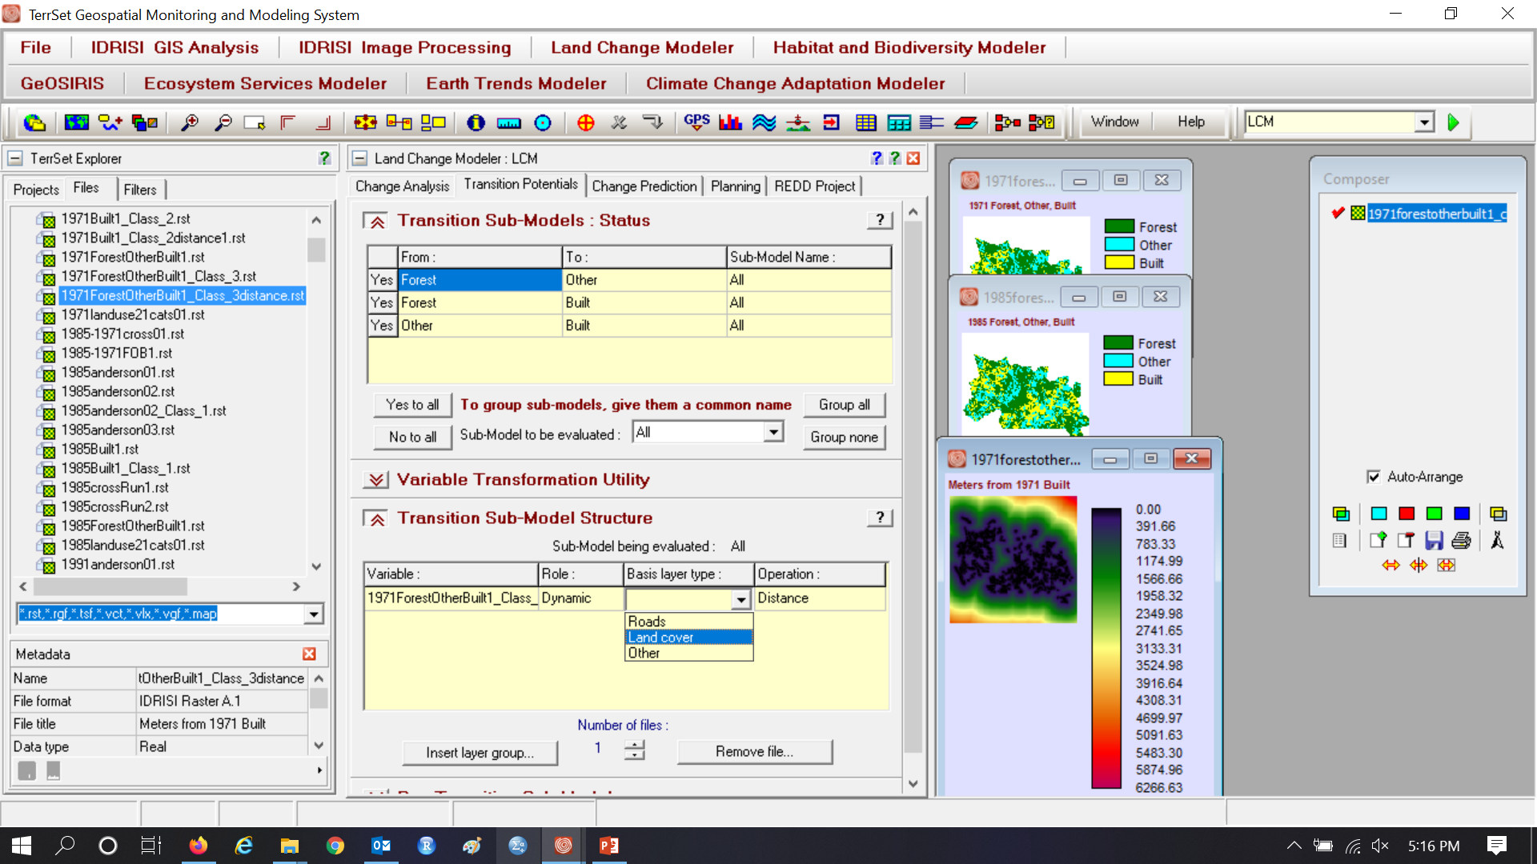
Group all, Variable is Distance to 1971 Built. First run has Role as Static.

Slide 10
Group all, Variable is Distance to 1971 Built, Second Run has Role as Dynamic, Basis is Built Cover.

Slide 11
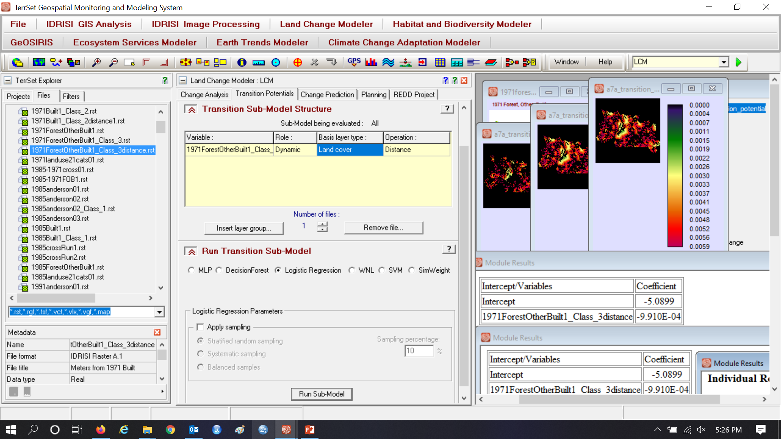
Logistic Regression without Sampling

Slide 12
Make an incentive to build on higher elevations

Slide 13
Assignment 7 using Logistic Regression Soft

Slide 14
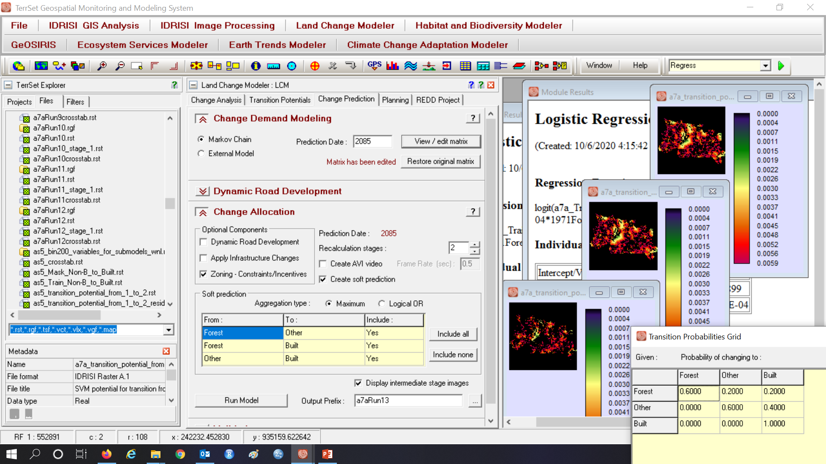
Simulate to 2085 with and edited Markov matrix

Slide 15
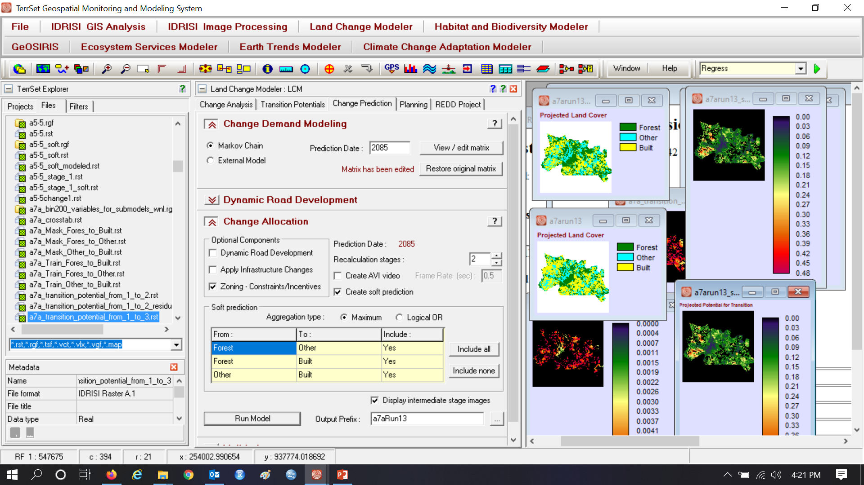
Assignment 7 gives output for two 50-year stages

Slide 16
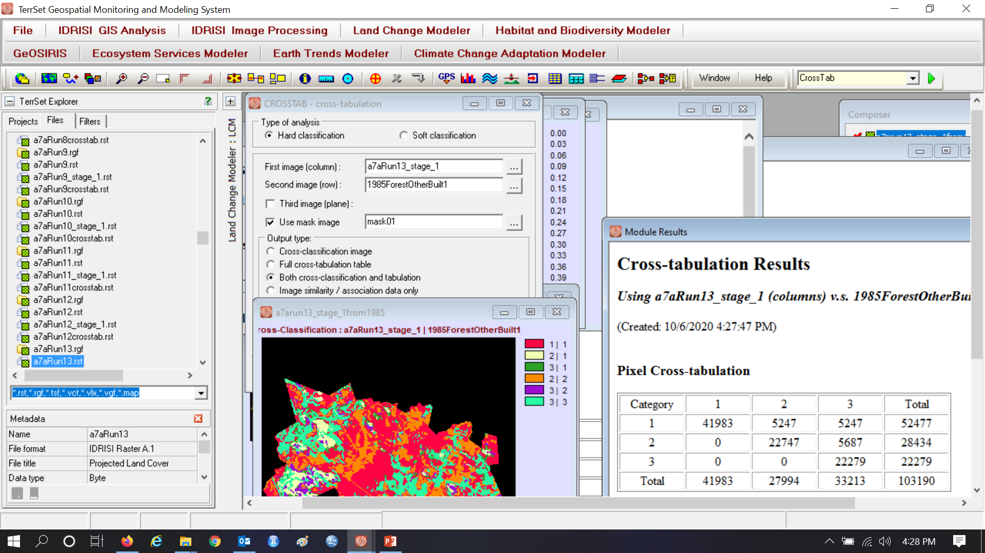
Assignment 7 using Logistic Regression 1985-2035

Slide 17

Assignment 7 using Logistic Regression 2035-2085

Slide 18
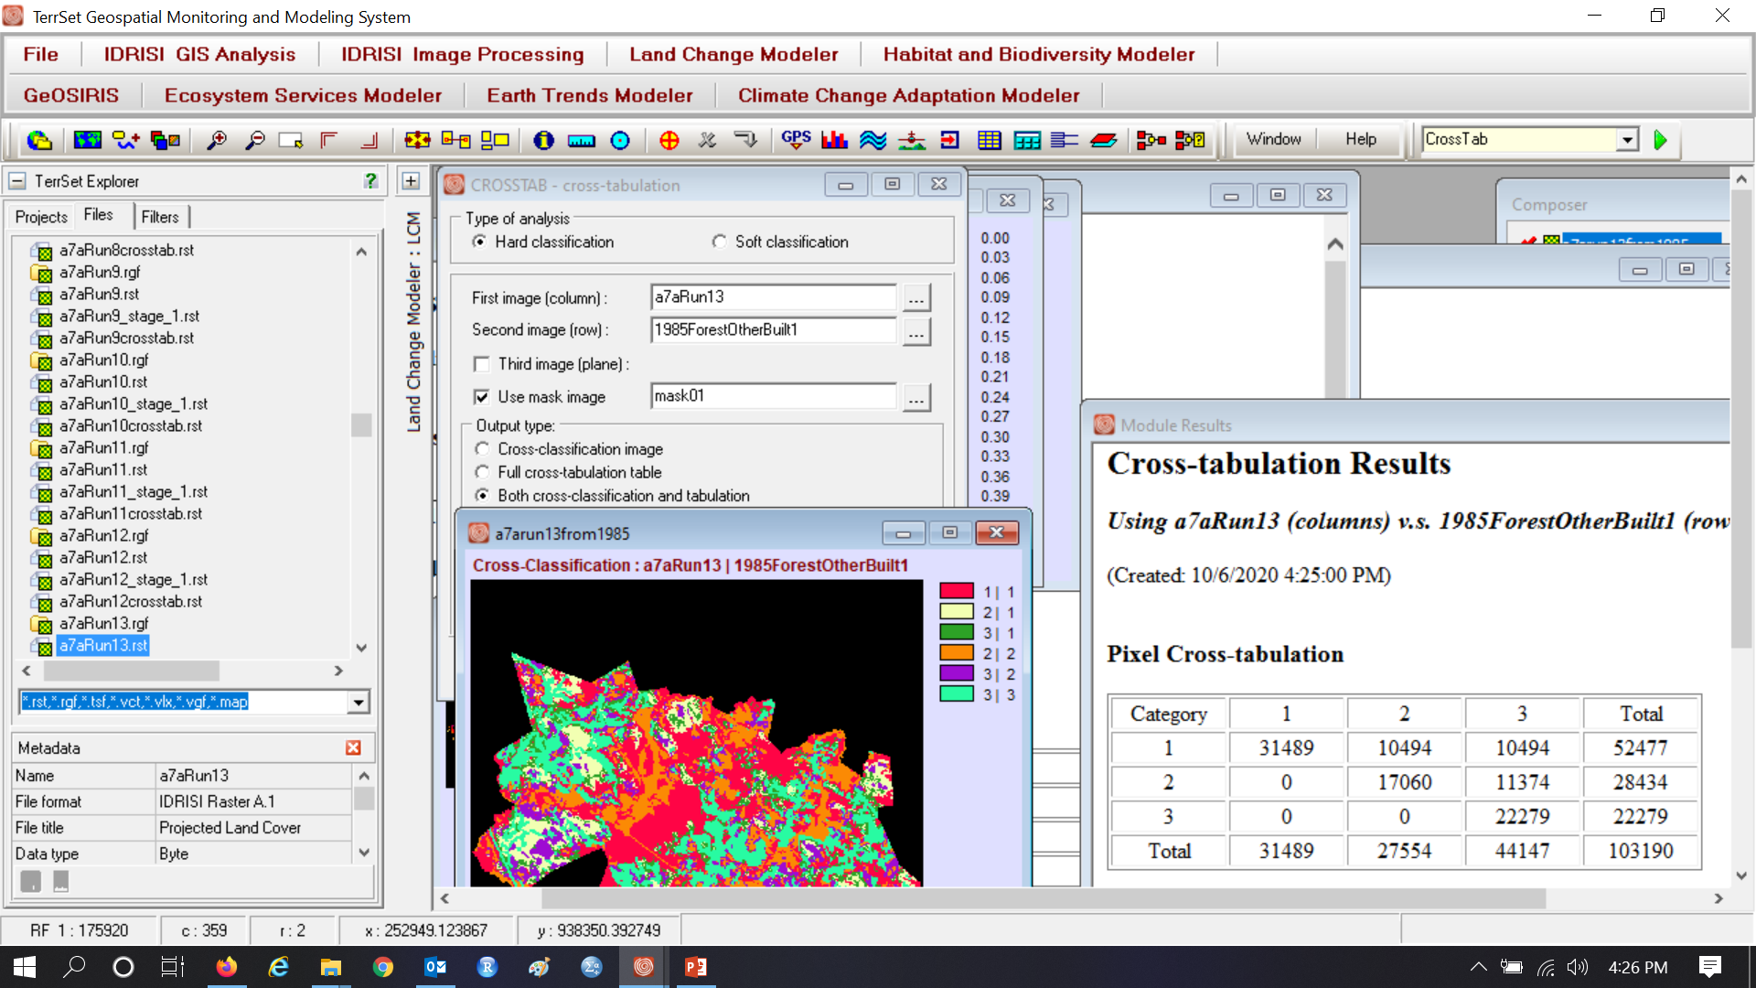
Is the Markov computation verified when using Logistic Regression with static variable?

Slide 19
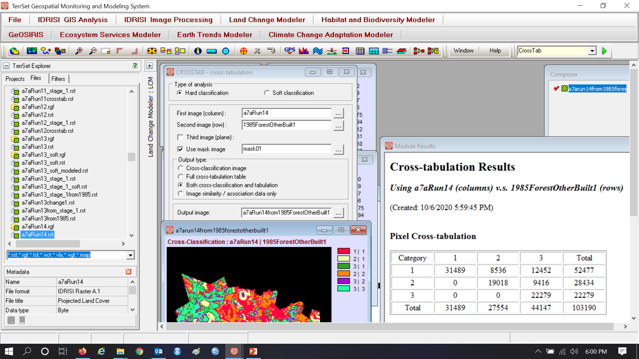
Is the Markov computation verified when using distance as a dynamic variable? Why is there a difference in output between using the distance variable as static variable versus dynamic? How can we unravel the riddle?

Slide 20
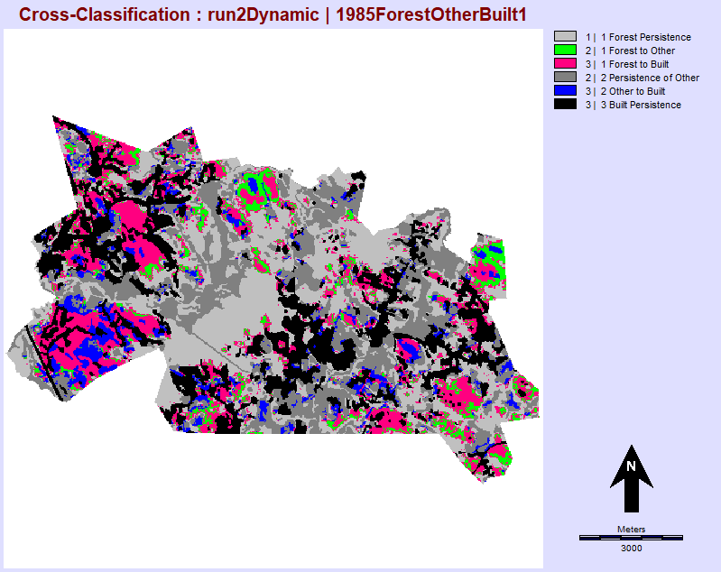
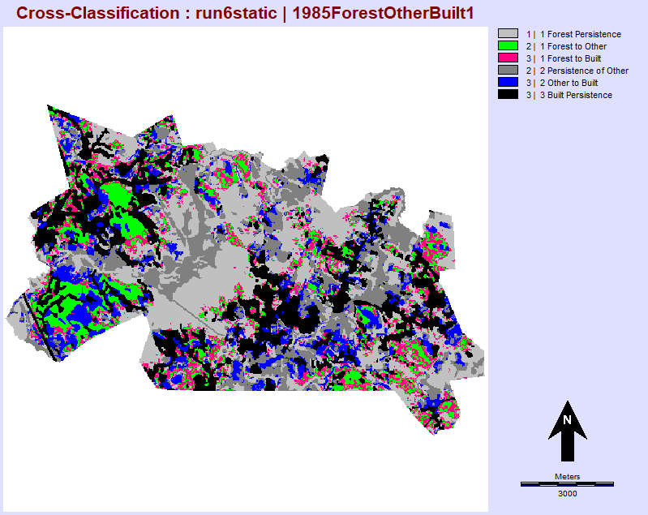
Simulated change from 1985 to 2085 for Static distance variable on the left and dynamic distance variable on the right. The most recent version of TerrSet is 19.08, which handles a dynamic variable differently than from last year. Tammy Woodard (TaWoodard@clarku.edu)is interested in a final project that describes potential improvements to the software.

Slide 21
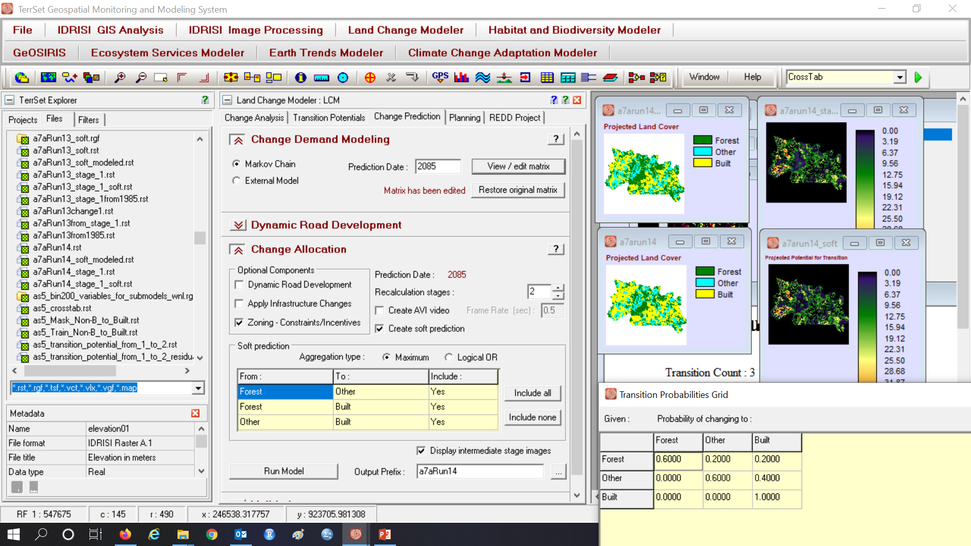
Use EXTRACT to compute the transition potentials for the transitions from Forest to Other and from Forest to Built. If the transition potential maps for these two transitions are identical, then how does LCM decide whether a particular Forest pixel transitions to Other or Built?

Slide 22
What are the software needs of Scenario modeling and Predictive modeling?
A scenario modeler must be able to control the future quantity of each land class and the spatial allocation of the gain of each land class.
A predictive modeler needs the same things as a scenario modeler. In addition, a predictive modeler needs some way to assess the level of trust that users should have in the prediction.
TerrSet’s Land Change Modeler is a pattern-based model that is strong in both of these characteristics.
Some other models are weak in both of these characteristics, due frequently to poor documentation.

Slide 23
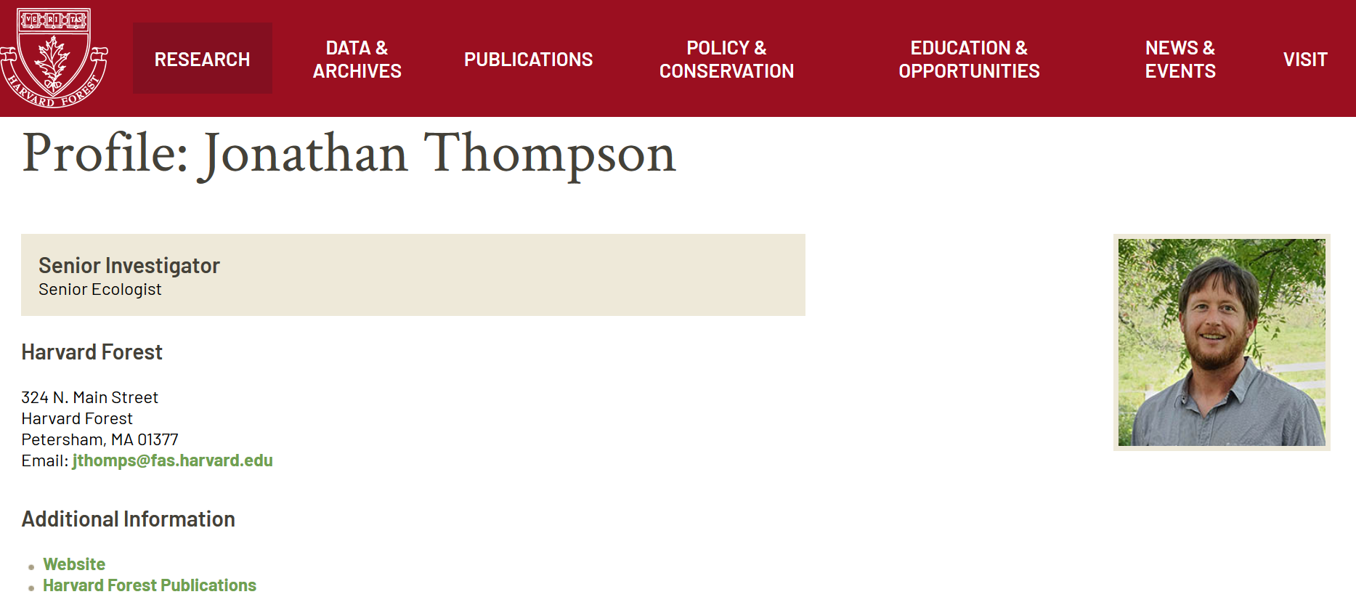

Pontius thought that New England Landscape Futures (NELF) was the most helpful way to approach modeling for policy development. But then Thompson said that most people wanted to see only the Recent Trends Scenario while ignoring the other scenarios.

Slide 24
Would a Maximum Buildout Scenario be helpful? If so, helpful for what? If not, why not?
MassGIS created a Maximum Buildout Scenario, which has a storyline that all legally-developable land is developed to its capacity assuming existing zoning laws. The story line lacks details concerning when maximum buildout would be reached, nor the sequence of where the parcels will be developed.
Planners then computed the necessary services assuming the Maximum Buildout Scenario. These services include: water, electricity, schools, police, transportation, etc.
Planners printed large maps for each town and toured of the towns of Massachusetts to facilitate discussions and collect insights from citizens.

Slide 25
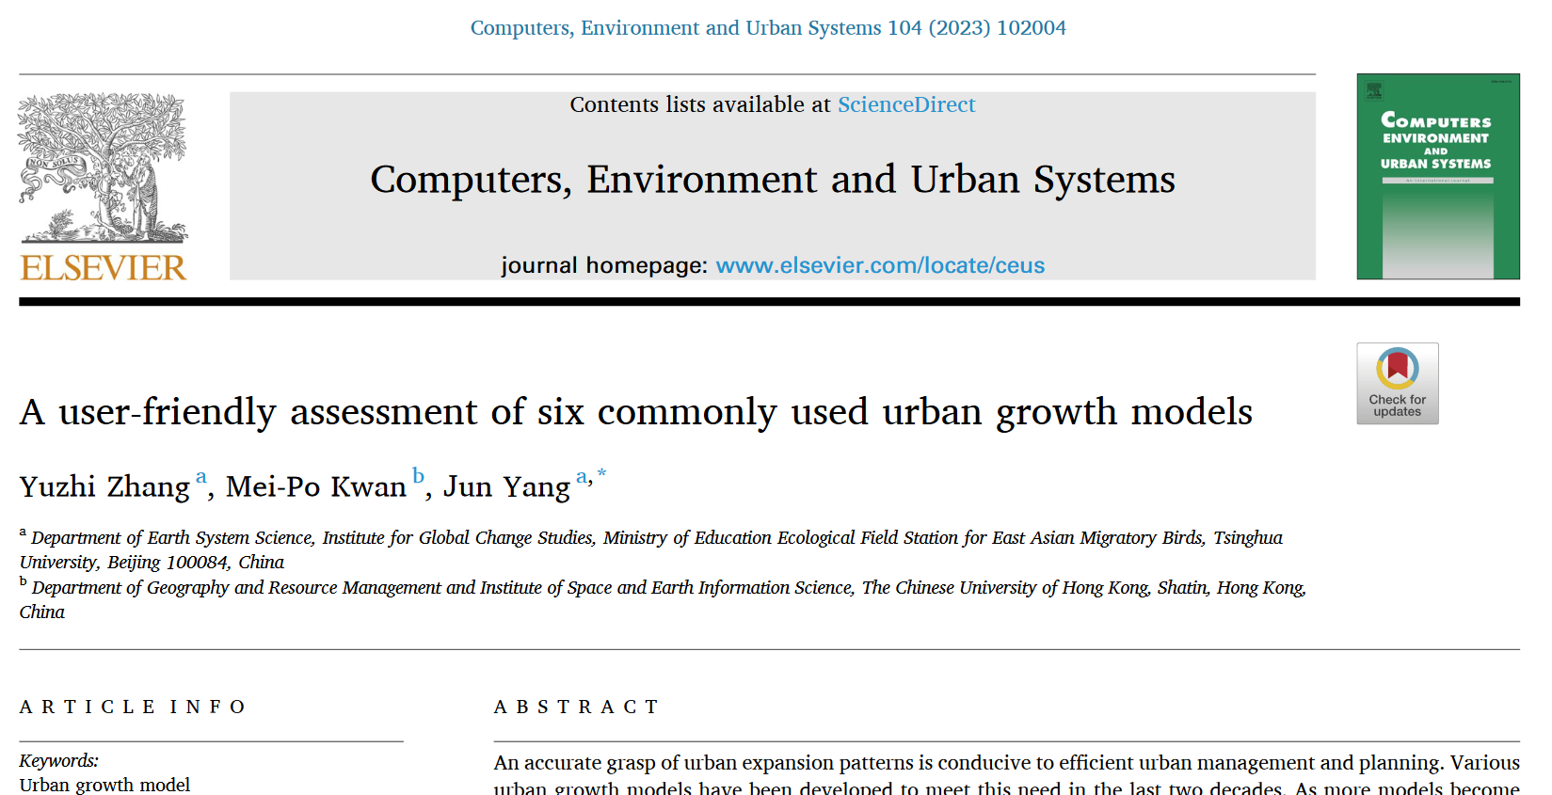
This is a helpful manuscript.

Slide 26
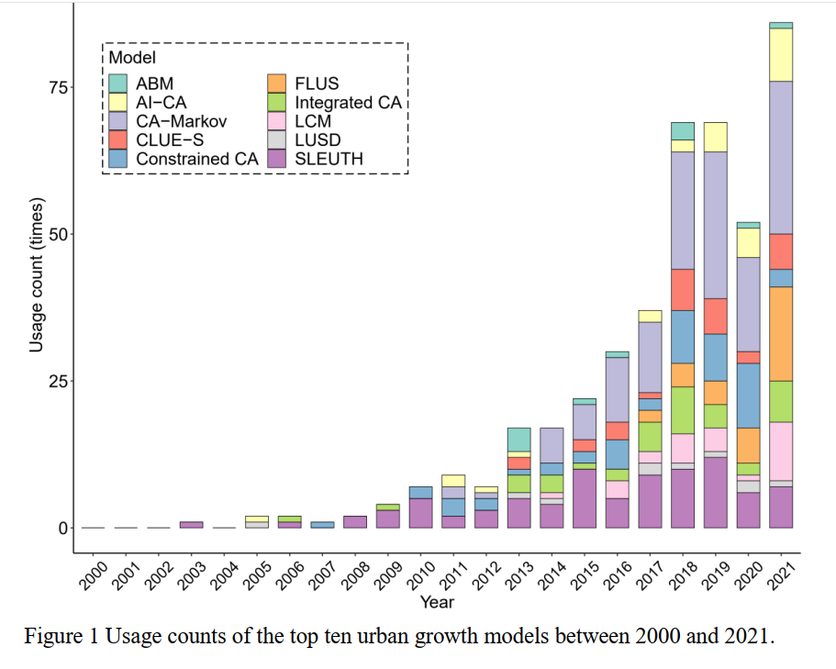

Urban growth modeling is increasing in the literature. CA-Markov and LCM in TerrSet are influential.

Slide 27
What advice do you have for authors who compared urban growth models
Authors compared six urban growth models to advise others which models to use. The authors analyzed a city where the calibration interval was 2002-2015 and validation interval was 2015-2020. The authors never state the size of urban growth during the calibration interval or validation interval.
Three of the models use the Markov matrix to extrapolate the quantity from the calibration interval to the validation interval.
Those three models varied in their simulated quantities, specifically simulating 84, 137, and 177 square kilometers of urban gain.
The authors used validation to show that the models had errors that were from 6 to 14 times larger than hits.
The authors conclude that others should use their methodology for more case studies.

Slide 28
What do you think of the title of this journal article?
Multi-Scenario Prediction of Intra-Urban Land Use Change Using a Cellular Automata-Random Forest Model
https://www.mdpi.com/2220-9964/10/8/503/htm

Slide 29
What do you think of the title of this journal article?
Multi-Scenario Prediction of Intra-Urban Land Use Change Using a Cellular Automata-Random Forest Model
https://www.mdpi.com/2220-9964/10/8/503/htm
The title indicates that the authors confuse Scenarios with a Prediction. The article claims that the model can predict accurately. Thus the authors claim that their model is useful to make various scenarios.
This makes no sense. Pontius suspected the article would make little sense as soon as he saw the first words of the title.

